Slide 1

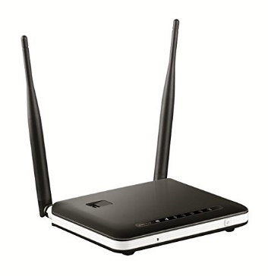
Evaluate Techniques for Wifi Locationing
Asad Aftab
IoT Analytics

Slide 2
agenda
Goals of the project
Background and Research
Location of data and sources
Data characteristics
Data Management
Known issues with the data
Data strategy and solution
Making the data ready
Making the environment ready
Models tried
Comparison of models
Recommended ML Model
Recommendations

Slide 3
GOALS OF THE PROJECT
Evaluate WiFi fingerprinting data from an industrial campus.
Use multiple machine learning algorithms to predict the probable user location based on the mobile device location.
Compare at least three machine learning models for WiFi locationing.
Document results and summary for each model, store confusion matrix and performance measures for each model.
Find and recommend the most optimal machine learning model to evaluate and predict the mobile/user in-building location in terms of building, floor etc.

Slide 4
Background and research
While GPS has been a well established technology for outdoor locationing it has not performed well for indoor locationing due to presence of roofs, walls, multiple stories etc.
Various systems have been developed for indoor locationing using beacons, lights, magnetic fields, RFIDs etc. In this assignment we are using WiFi fingerprinting as the locationing technology.
Each WiFi fingerprint can be characterized by the detected Wireless Access Points (WAPs) and the corresponding Received Signal Strength Intensity (RSSI).
The intensity values are represented as negative integer values ranging -104dBm (extremely poor signal) to 0dbM.
The positive value 100 is used to denote when a WAP was not detected.
During the database creation, 520 different WAPs were detected. Thus, the WiFi fingerprint is composed by 520 intensity values.

Slide 5
Location of data and sources
The data for this project is located in University of California at Irvine (UCI) Machine Learning Repository.
The name of the dataset is UJIIndoorLoc Data Set and it is located at the following URL: http://archive.ics.uci.edu/ml/datasets/UJIIndoorLoc
Details: The UJIIndoorLoc is a Multi-Building Multi-Floor indoor localization database to test Indoor Positioning System that rely on WLAN/WiFi fingerprint.
Data Set Characteristics: | Multivariate | Number of Instances: | 21048 | Area: | Computer
Attribute Characteristics: | Integer, Real | Number of Attributes: | 529 | Date Donated | 2014-09-18
Associated Tasks: | Classification, Regression | Missing Values? | N/A | Number of Web Hits: | 88395

Slide 6
Data characteristics
The UJIIndoorLoc database covers three buildings of Universitat Jaume I with 4 or more floors and almost 110.000m2.
It can be used for classification, e.g. actual building and floor identification, or regression, e.g. actual longitude and latitude estimation.
The 529 attributes contain the WiFi fingerprint, the coordinates where it was taken, and other useful information.
There are 520 Wireless Access Points (WAP), the positive value of 100 is used to denote when a WAP was not detected.
Data fields:
LONGITUDE
LATITUDE
FLOOR
BUILDINGID
SPACEID
RELATIVEPOSITION
USERID
PHONEID
TIMESTAMP
WAP001 through WAP520

Slide 7
Data management
Data was copied on the local drive and was used for machine learning algorithms on RStudio.
The database file consisting of 19937 training/reference records (trainingData.csv file) was used both for training and testing.
The file with 1111 validation/test records (validationData.csv file) was ignored for this project due to issues with the data in that file.

Slide 8
Known issues with the data
Issues:
The data consists of 529 columns which were too many to do any meaningful analysis in time on a HP Laptop that was used.
Since validationData.csv file was ignored so trainingData.csv was split into training and testing data.
19937 rows along with 529 columns brought the laptop to a crawl where it took several hours for analysis of some models and for other models the laptop crashed – SVM did not produce any result despite running all night.
Many WiFi / WAP locations were dead in terms of the signal strength and there were spots with no coverage
The above issues required for a strategy on data reduction / sampling, it was necessary to do this reduction in a intelligent manner to preserve data integrity in order to be able to draw meaningful results.

Slide 9
Data Strategy and solution
Building ID = 2 was chosen for this analysis to reduce about 10000 rows but still have one complete building with all floors i.e. 9492 rows, used for analysis.
BUILDINGID, FLOOR, SPACEID and RELATIVEPOSITION were merged into a single field / column (location) to create the dependent variable for e.g. 2_3_127_2 and after that those four columns were removed to avoid over-fitting.
LONGITUDE, LATITUDE, USERID, PHONEID and TIMESTAMP were removed from the dataset to avoid overfitting.
After these steps the data only had the dependent variable and the 520 WAP locations.
Building ID | Number of rows
0 | 5249
1 | 5196
2 | 9492

Slide 10
Making the data ready for ML
The next step was to reduce / eliminate the WAP locations with no data of interest present, for that nearZeroVar() function was used to identify the columns (WAPs) with zero variances. These columns were removed reducing the total number of columns to just 204.
9492 rows identified in previous slide were divided into training / testing data using 80/20 ratio.
10 fold cross validation method was used with different classification algorithms as final outcome was to predict the location i.e. Building ID, floor etc. or the dependent variable (location).
Location was converted as a factor in the initial data as well as the training and testing data in order for ML algorithms to work properly.

Slide 11
Making the environment ready for ML
By default RStudio only uses one core in the machine / laptop.
Library doParallel was included and detectCores() was used to find that there were 4 cores available in the laptop.
3 cores were clustered together to run the training exercises with different models.
At the end of the exercise those cores were released back to the operating system.

Slide 12
Models tried
Various models were used for training purpose, the effort can be divided in terms of three categories:
Models that yielded very low accuracy, for e.g. RPART
Models that yielded no results and caused crashes of RStudio / Laptop, for e.g. SVM and GBM
Models that ran successfully in acceptable time and provided acceptable results for e.g. RF and KNN
Model founds in categories 1. and 2. above were discarded and models found in category 3. were studied further for this task.
Models selected for study were: RF, C5.0, KKNN and KNN

Slide 13
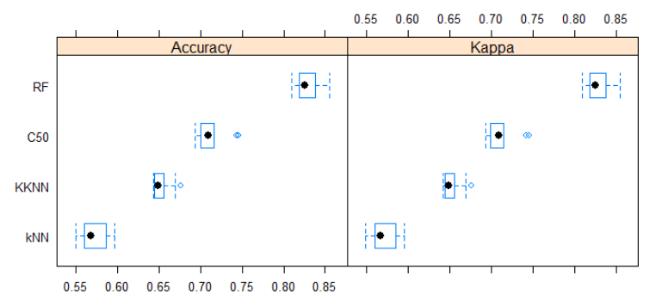
Comparison of models
 | Training Data |  | Testing Data
Model | Accuracy | Kappa | Accuracy | Kappa
RF | 0.83 | 0.83 | 0.93 | 0.93
C5.0 | 0.71 | 0.71 | 0.91 | 0.91
KKNN | 0.65 | 0.65 | 0.67 | 0.67
KNN | 0.57 | 0.57 | 0.62 | 0.61
Detail results for each model including performance measures and confusion matrixes are captured in the separate files that have been submitted, here we are only looking at the summary.

Slide 14
Recommended ML algorithm/model
Four classification methods / models were compared, Random Forest (RF) predicted the locations with 93% accuracy and was chosen as the final model to be used in the mobile app for predicting indoor locations.
In general RF performs well for large dimensions of data, once the model has been trained, predictions are quick.
Even though this exercise focused on building # 2 the same logic can be used for other buildings and campuses as well.
Once higher processing power like cloud computing is available this exercise should be repeated on the full dataset.

Slide 15
Recommendations on improving the results
Dead spots should be identified in the buildings and additional WAPs should be placed to eliminate them.
Data should be collected during the busy hour as well as off peak hours.
If the user device is connected to a particular WAP, it should be identified in the data to help pin point the location.
The whole dataset should be used for training after the availability of cloud computing.
Location should be found by longitude / latitude as well using regression algorithms and classification results using WiFi fingerprinting should be tallied to find the best algorithm in different cases or to come up with a hybrid solution.

Slide 16

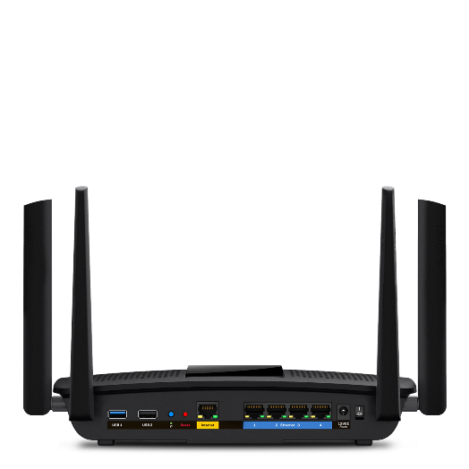
Thank You
This Photo by Unknown Author is licensed under CC BY-NC

